Slide 1
Windows 10 Module 8
Managing Windows Devices

Slide 2
Module Objectives
View Windows devices
Install a printer
View printer properties
Share a printer
Manage printers and print jobs
Install hardware devices
Remove hardware devices
Sync your Windows 10 devices

Slide 3
View Windows Devices (Slide 1 of 3)
Windows uses plug-and-play technology for hardware, making it easy to install and uninstall devices quickly
A device is physical hardware that you plug into and that is controlled by your system
With plug-and-play support, Windows configures the plugged in device
A driver allows the hardware to communicate with Windows and other software
USB is an external hardware interface that can connect up to 127 peripheral devices

Slide 4
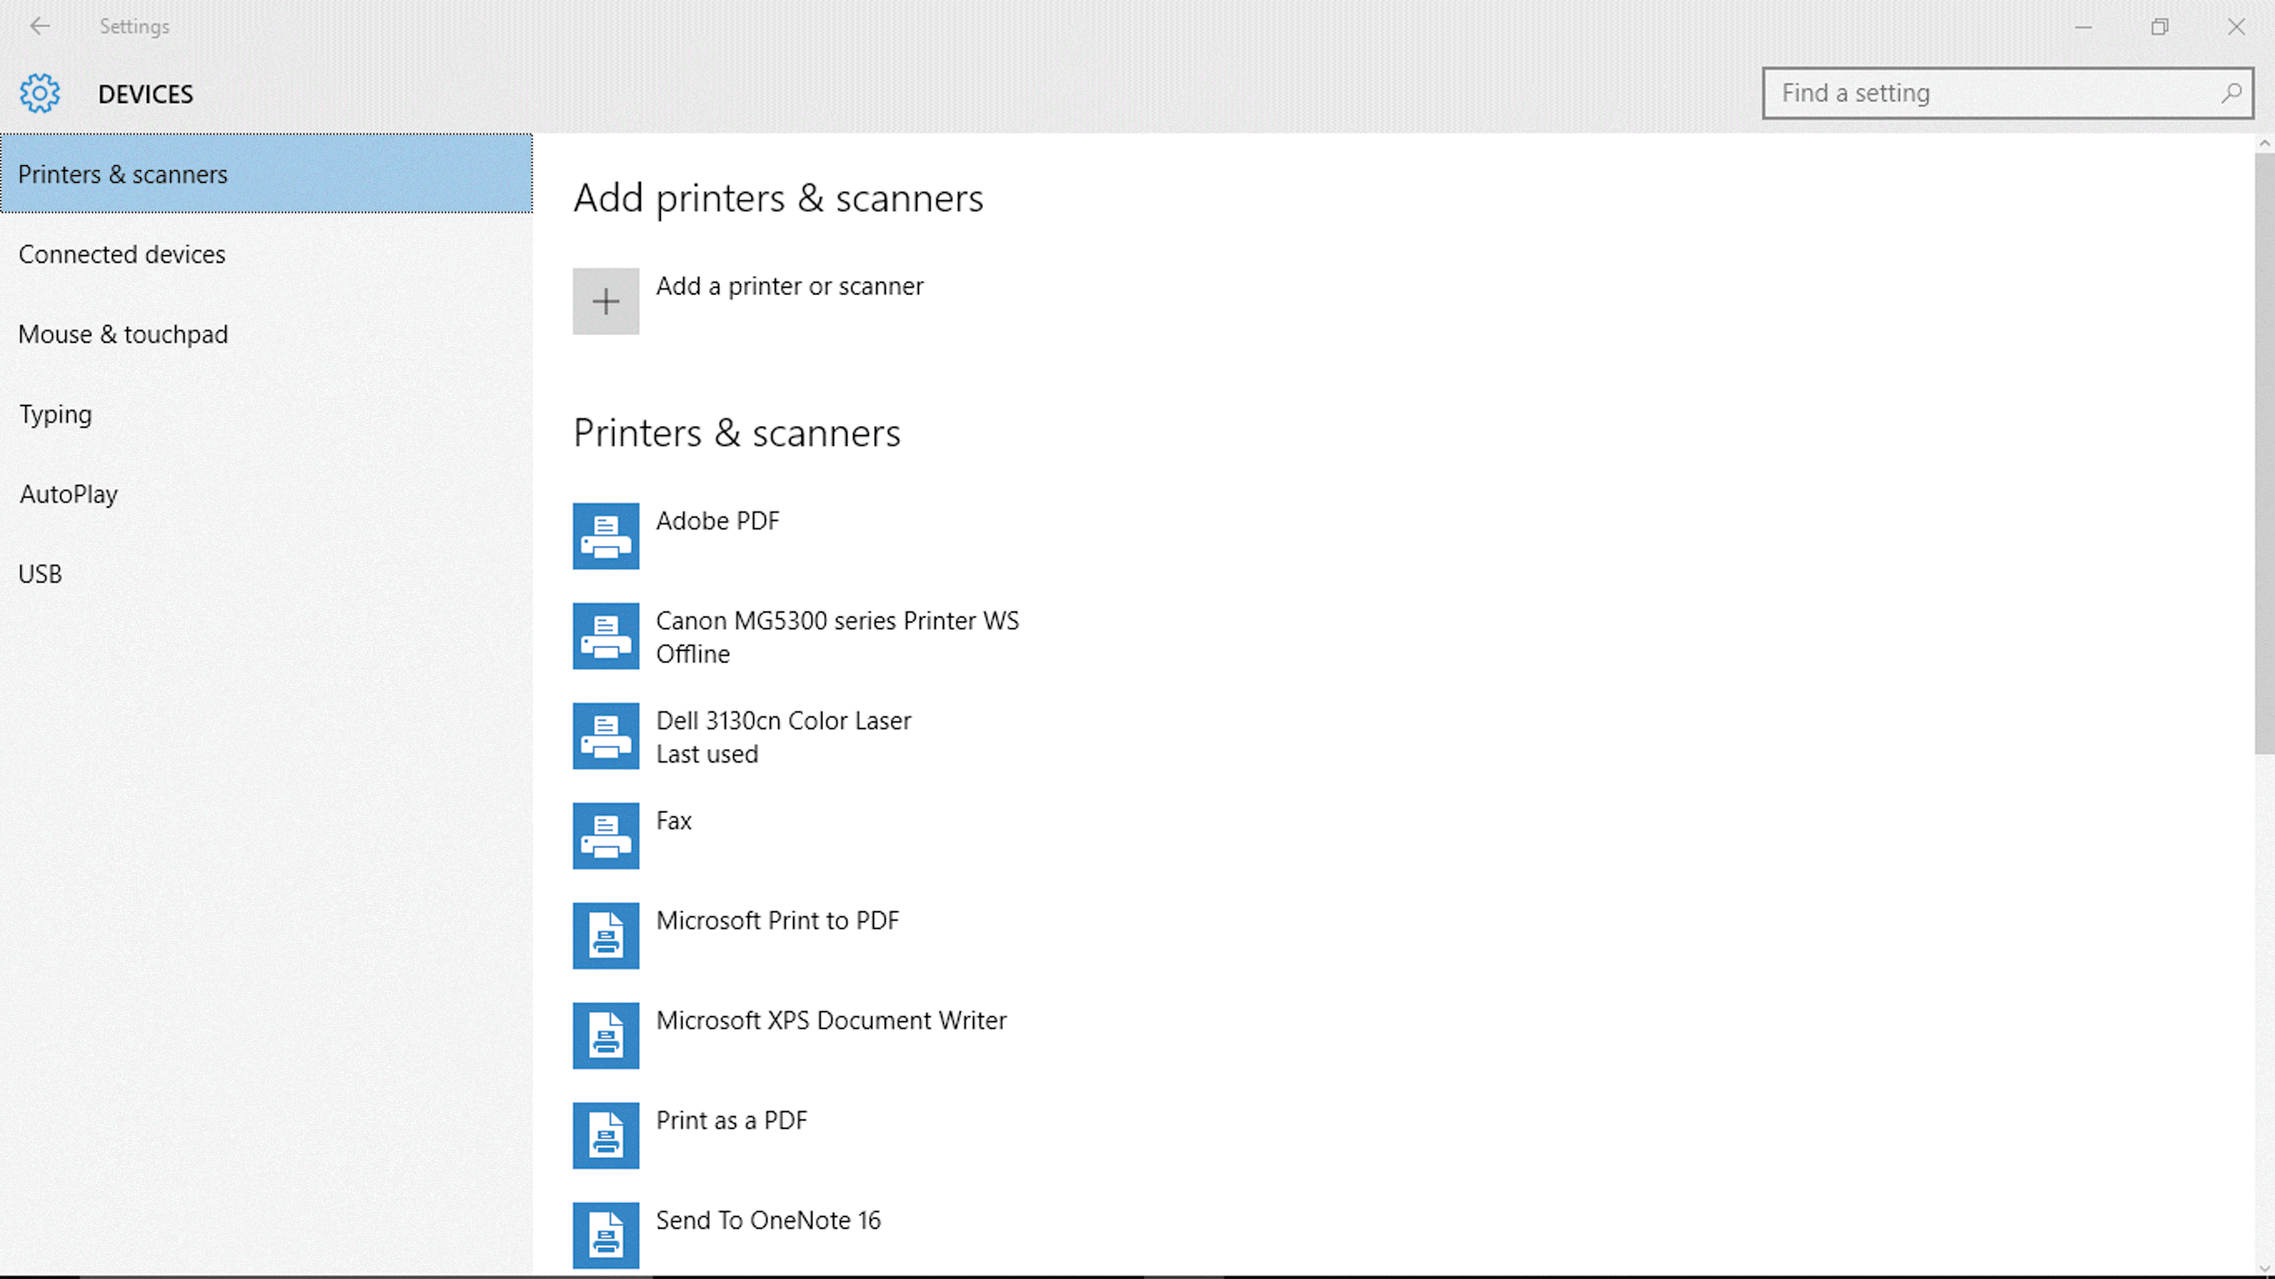
View Windows Devices (Slide 2 of 3)
Viewing devices in the Settings app

Slide 5
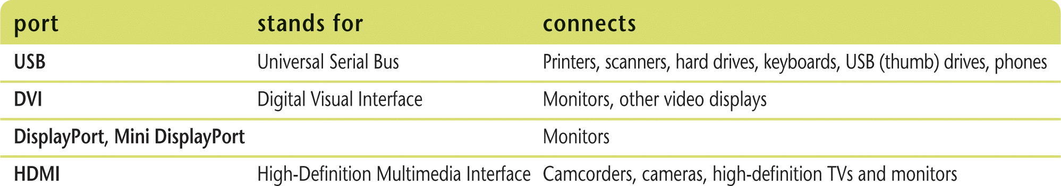
View Windows Devices (Slide 3 of 3)
Hot-pluggable or hot-swappable devices
Don’t need to turn off computer first
Legacy devices are devices that are no longer compatible with system
Common computer ports

Slide 6
Install a Printer (Slide 1 of 2)
To install a printer, simply attach the printer cable to the appropriate connector and plug in the power cord
A local printer is a printer directly connected to your computer
A network, wireless, or Bluetooth printer is connected to either a wired or wireless network
Bluetooth is a wireless short-range radio connection

Slide 7
Install a Printer (Slide 2 of 2)
Inkjet printer
Sprays ionized ink at a sheet of paper
Laser printer
Uses a laser beam to produce an image on a drum, which is rolled through toner and transferred to paper using heat and pressure
Printer resolution
Sharpness or clarity of printed page
Measured in number of dots per inch (dpi)
Printer speed
Measured in pages per minute (ppm)

Slide 8
View Printer Properties (Slide 1 of 3)
Access installed printers and view their properties from the Devices and Printers window
You can view printer properties to get information about a printer’s computer connection and settings
Spooling, or background printing, is the process of storing a temporary copy of a file on the hard disk and then sending the file to the print device

Slide 9
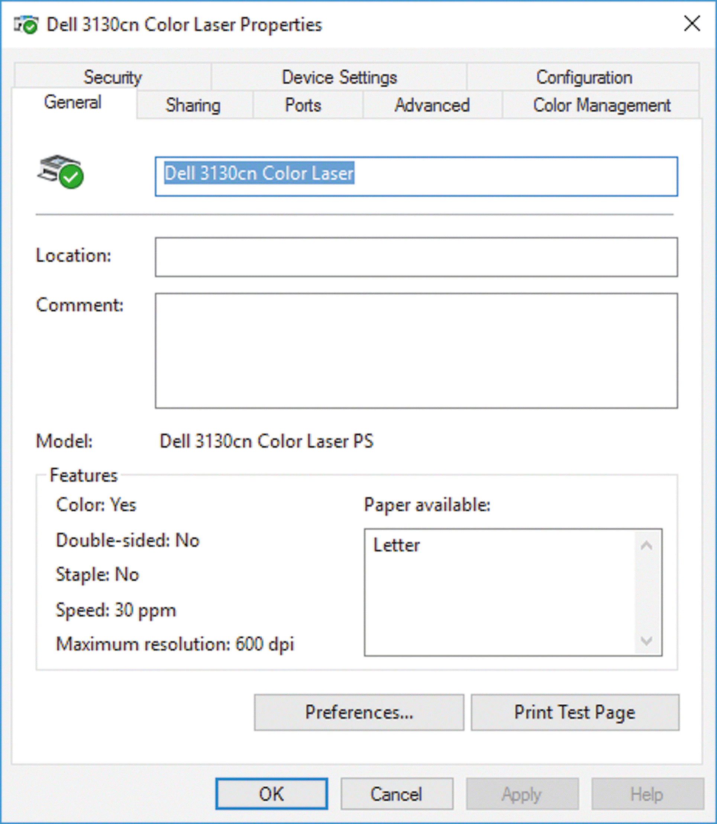
View Printer Properties (Slide 2 of 3)
Properties dialog box with the General tab displayed

Slide 10
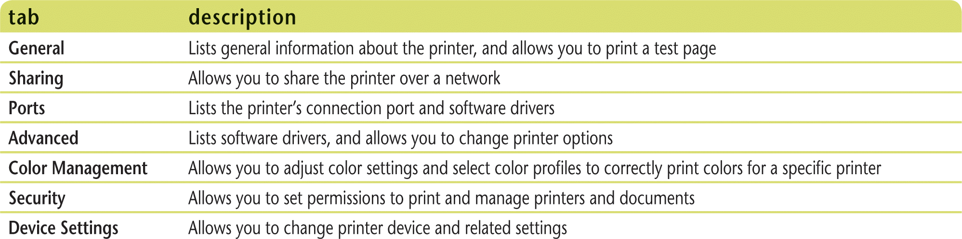
View Printer Properties (Slide 3 of 3)
Printer options tabs in the printer Properties dialog box

Slide 11
Share a Printer (Slide 1 of 2)
A shared printer is a printer you share on a network with other network users
Printer sharing can be turned on in the Network and Sharing Center window
Access through the Sharing tab in the printer Properties dialog box

Slide 12
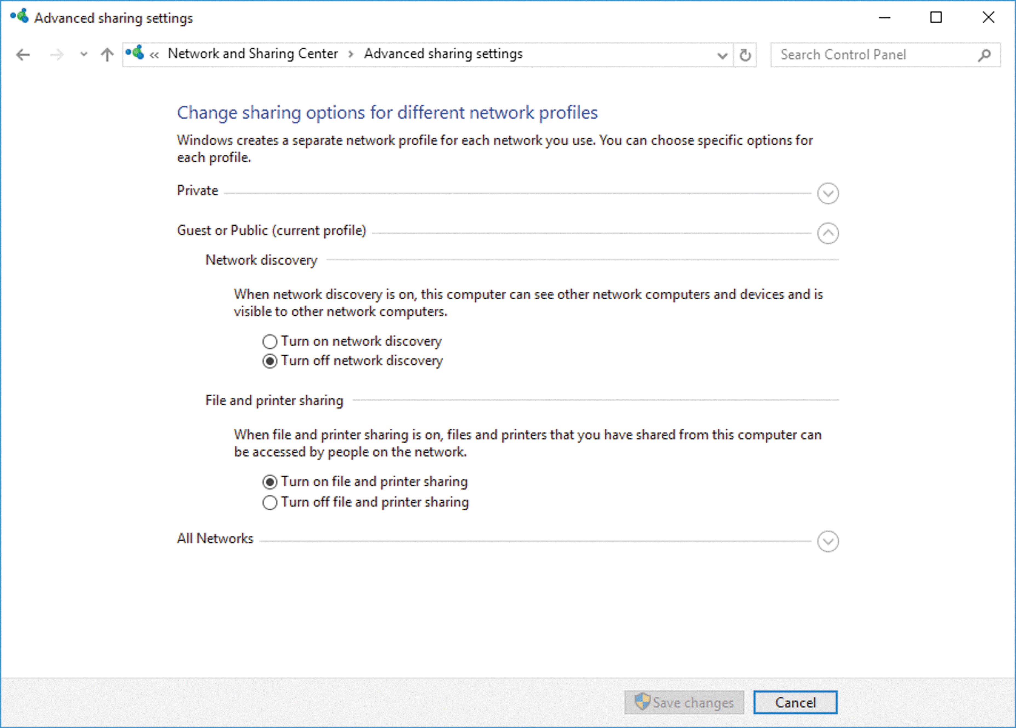
Share a Printer (Slide 2 of 2)
Advanced sharing settings window

Slide 13
Manage Printer and Print Jobs (Slide 1 of 2)
To check the status of a print job, you can display
Tiles view
Details pane with a selected device in the Devices and Printers window
To manage a print job, open the appropriate printer icon in the Devices and Printers window
A print queue is a list of files to be printed
You can defer, or halt, the printing process if necessary

Slide 14
Manage Printer and Print Jobs (Slide 2 of 2)
Device Manager
Organizes all hardware devices attached to your computer by hardware types also called hardware classes
Alerts you to potential problems with a specific device

Slide 15
Install Hardware Devices
Before you install a hardware device, read the product documentation
If the hardware device comes with an installation disc
Do not use the Windows 10 Add a device Wizard
Instead use the disc and instructions that came with the device
Can connect to the Internet ISP in several ways
DSL (digital subscriber line) provides a completely digital connection
Cable uses cable television lines
DSL and cable are broadband connections
Use a modem (Modulate/Demodulate)

Slide 16
Remove Hardware Devices
Before removing physical hardware, remove the hardware device drivers and related software
Use the Manufacturer’s instructions when available
Use the Remove Device button in the Devices category in the Settings app or Devices and Printers window in Control Panel
For USB devices, in many cases, you can simply unplug the device when it is not in use
Can add a second monitor to system using the Settings app

Slide 17
Sync Your Windows 10 Devices (Slide 1 of 2)
If you have multiple devices, you can sync (short for synchronize) system and app settings so that they are the same
You can set up automatic syncing between devices that use the same Microsoft account

Slide 18
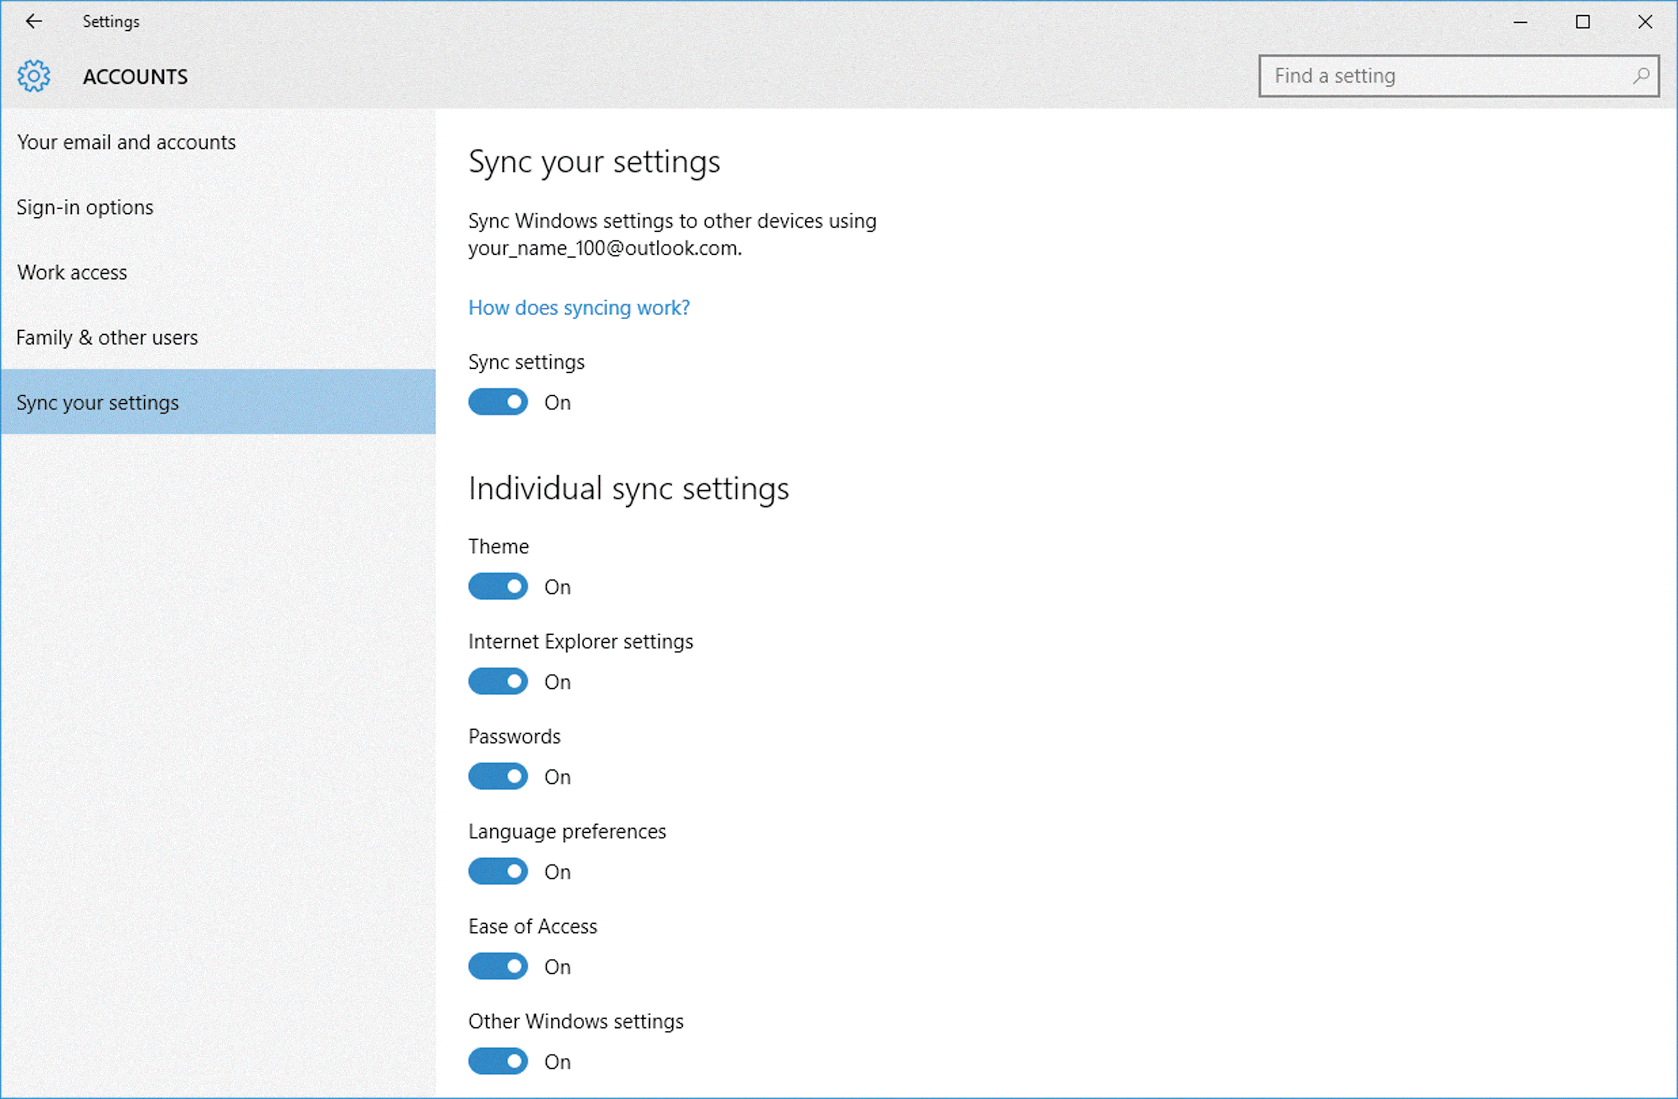
Sync Your Windows 10 Devices (Slide 2 of 2)
Enabled sync settings

